Slide 1


GO! with Microsoft 365®
Word 2025 Edition
Chapter 2
Creating Cover Letters and Using Tables to Create Resumes
Copyright © 2026, 2023, 2020 Pearson Education, Inc. All Rights Reserved
Notes:
If this PowerPoint presentation contains mathematical equations, you may need to check that your computer has the following installed:
1) Math Type Plugin
2) Math Player (free versions available)
3) NVDA Reader (free versions available)
GO! With Microsoft 365
Word 2025 Edition
Chapter 2: Creating Cover Letters and Using Tables to Create Resumes

Slide 2
Learning Objectives (1 of 2)
Create a Table for a Resume
Format Rows, Columns, and Cells in a Table
Format Paragraphs and Borders in a Table
Create a Letterhead for a Cover Letter
Create a Cover Letter and Correct and Reorganize Text
Notes:
The objectives of this chapter are:
Create a Table for a Resume
Format Rows, Columns, and Cells in a Table
Format Paragraphs and Borders in a Table
Create a Letterhead for a Cover Letter
Create a Cover Letter and Correct and Reorganize Text
Use the Word Editor to Check Your Document
Print an Envelope, Change a Style Set, Create a Word Template, Use Learning Tools, and Format a Resume for an Applicant Tracking System

Slide 3
Learning Objectives (2 of 2)
Use the Word Editor to Check Your Document
Print an Envelope, Change a Style Set, Create a Word Template, Use Learning Tools, and Format a Resume for an Applicant Tracking System
Notes:
Additional objectives are:
Use the Word Editor to Check Your Document
Print an Envelope, Change a Style Set, Create a Word Template, Use Learning Tools, and Format a Resume for an Applicant Tracking System

Slide 4
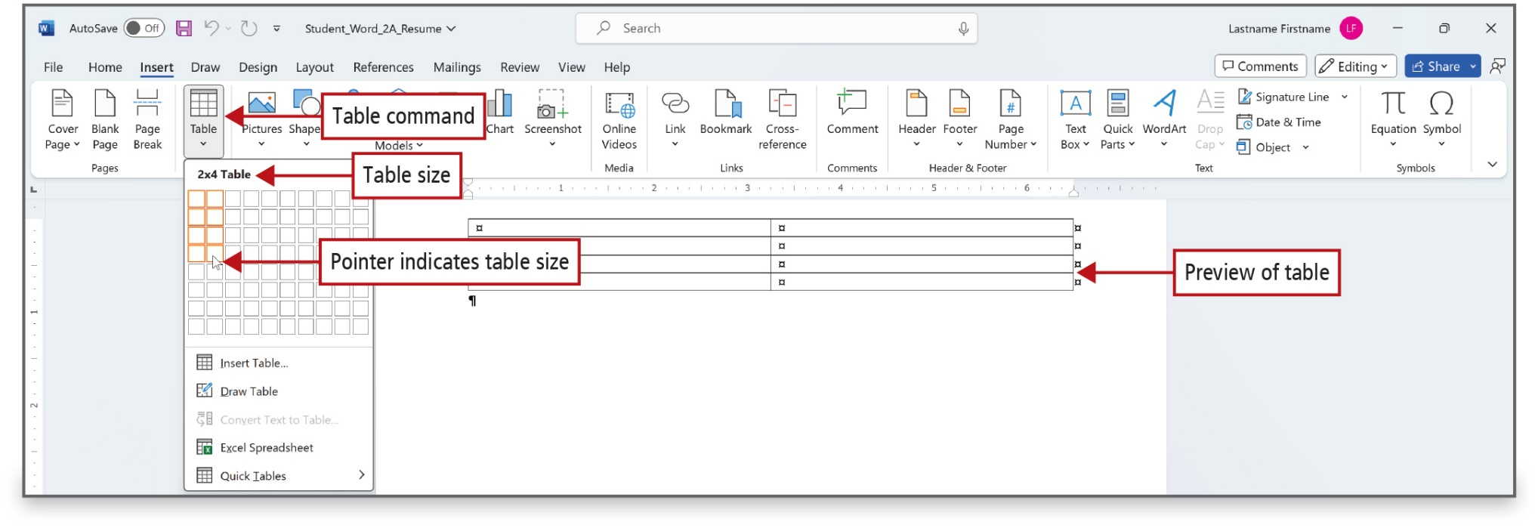
Figure 2.2
Notes:
A table is an arrangement of information organized into rows and columns. The intersection of a row and a column in a table creates a box called a cell into which you can type. Tables are useful to present information in a logical and orderly format. This could be a schedule, a list of classes, or many other types of information, including a resume.
Long Description:
The Table button dropdown is open under the Insert menu. A callout pointing to the dropdown reads, Table command. The dropdown has a square grid for selecting the number of columns and rows for a table to be created. Below the grid are options such as Insert Table, Draw Table, Excel Spreadsheet, and Quick Tables. In the square grid, two columns and four rows are selected and the text 2 by 4 Table is displayed above the grid. A callout pointing to the text reads, Table size. A callout pointing to the 2 by 4 selected area in the grid reads, Pointer indicates table size. An outline of the table is displayed in the document corresponding to the selected 2 by 4 area. The corresponding callout reads, Preview of table.

Slide 5
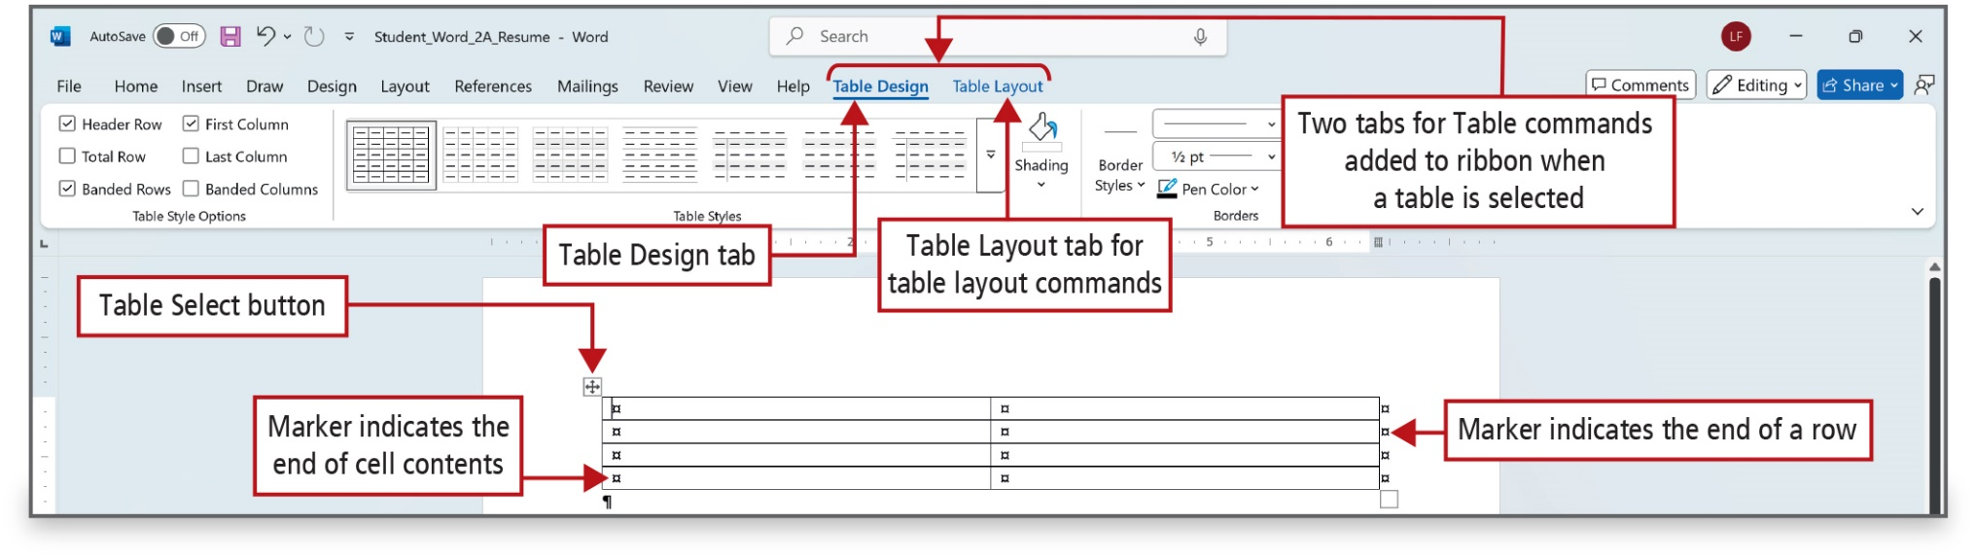
Figure 2.3
Notes:
As shown in the figure, a table with four rows and two columns displays at the insertion point location, and the insertion point displays in the upper left cell. The table fills the width of the page from the left margin to the right margin.
Long Description:
A 2 by 4 table is created on the document. The Table Design tab is selected and the Table Layout tab is displayed along with it. A callout points to the Table Design tab. A callout pointing to the Table Layout tab reads, Table Layout tab for table layout commands. A callout pointing to the Table Design and Table Layout tabs reads, Two tabs for Table commands added for ribbon when a table is selected. A callout pointing to a 4-directional pointer button at the top corner of the table reads, Table Select button. A square marker positioned left is in each cell of the table. A callout pointing to one of the square markers reads, Marker indicates the end of cell contents. At the right border of the table is a series of square markers arranged vertically. A callout pointing to one of the square markers at the right border of the table reads, Marker indicates the end of a row.

Slide 6
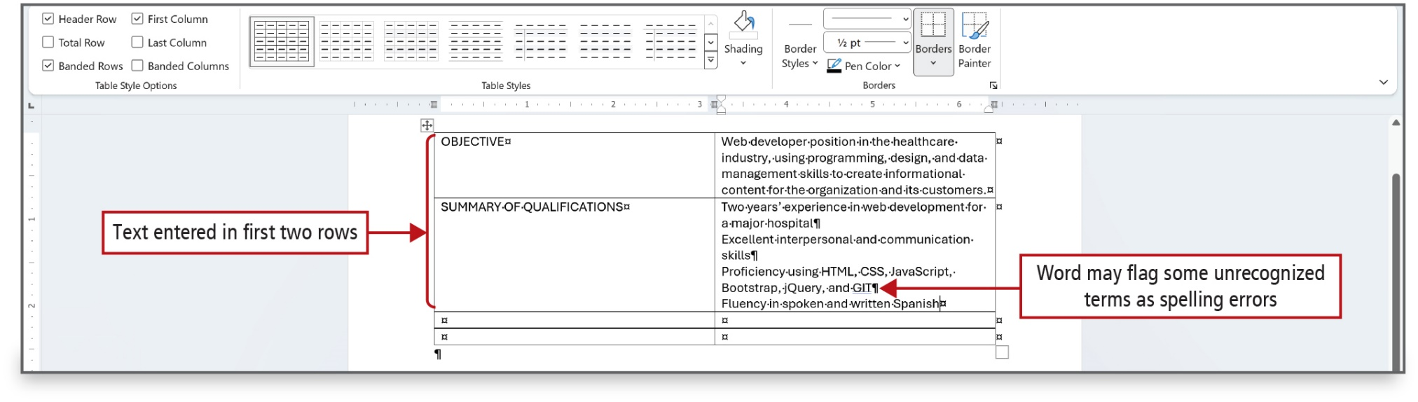
Figure 2.4
Notes:
Text typed in a table is inserted at the insertion point.
Long Description:
The screenshot highlighting different font options within a word processing program. The top portion of the screenshot shows a ribbon with various options. There are labels pointing to specific features: Change Case, Clear All Formatting, text effects and typography, Bold, Italic and Underline, Font Dialog Box Launcher, Font Color and Font Color arrow and Text Highlight Color and Text Highlight Color arrow. Each label is connected to its corresponding icon or menu in the ribbon.

Slide 7
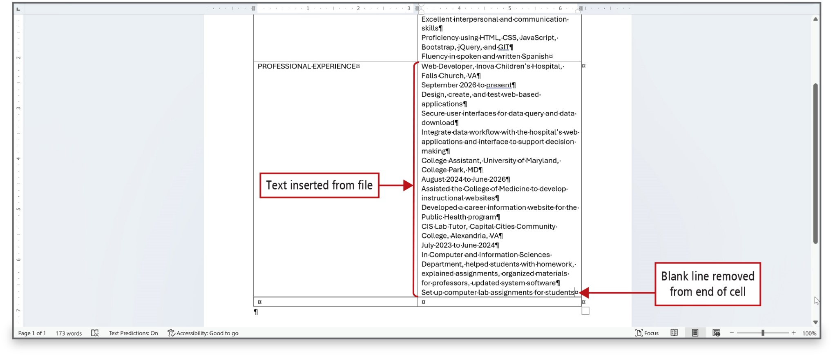
Figure 2.6
Notes:
The Text from File command is used to insert text from another file into a document.
Long Description:
The screenshot of a software interface, likely a word processing program. It shows a portion of the ribbon menu at the top with tabs like File, Home, Insert and others. The Home tab is selected and within it, the Font section is visible. A Text Effects and Typography gallery is open, displaying various text effect options such as Outline, Shadow, Reflection, Glow, Number Styles, Ligatures and Stylistic Sets. The gallery is highlighted with labels pointing to the Text Effects and Typography button, Ligatures and Stylistic Sets options.

Slide 8
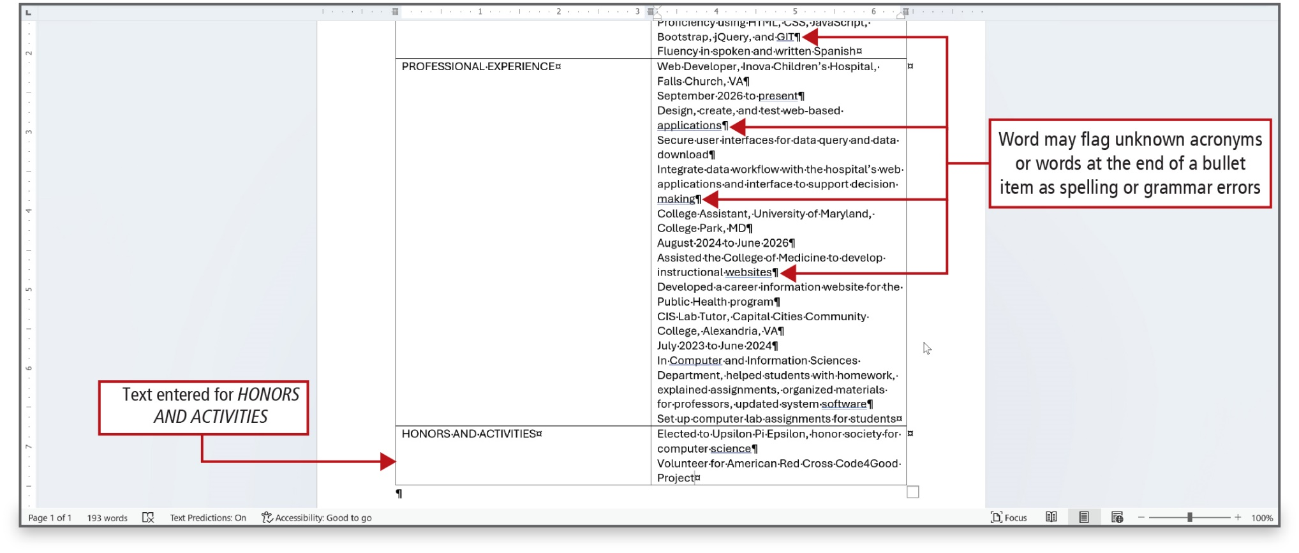
Figure 2.7
Notes:
Word may flag—with double blue lines—acronyms that are not in its dictionary as spelling errors. Word may also flag items at the end of short phrases as grammar errors.
Long Description:
The screenshot of a Colors dialog box with two tabs at the top labeled Standard and Custom. The Custom tab is selected. Inside the dialog box, there is a color palette for selecting a base color hue and a gradient bar for selecting a variation of the chosen color hue. Below the color palette, there are numerical values for Red, Green, Blue and a Hex code field, indicating the color model used.

Slide 9
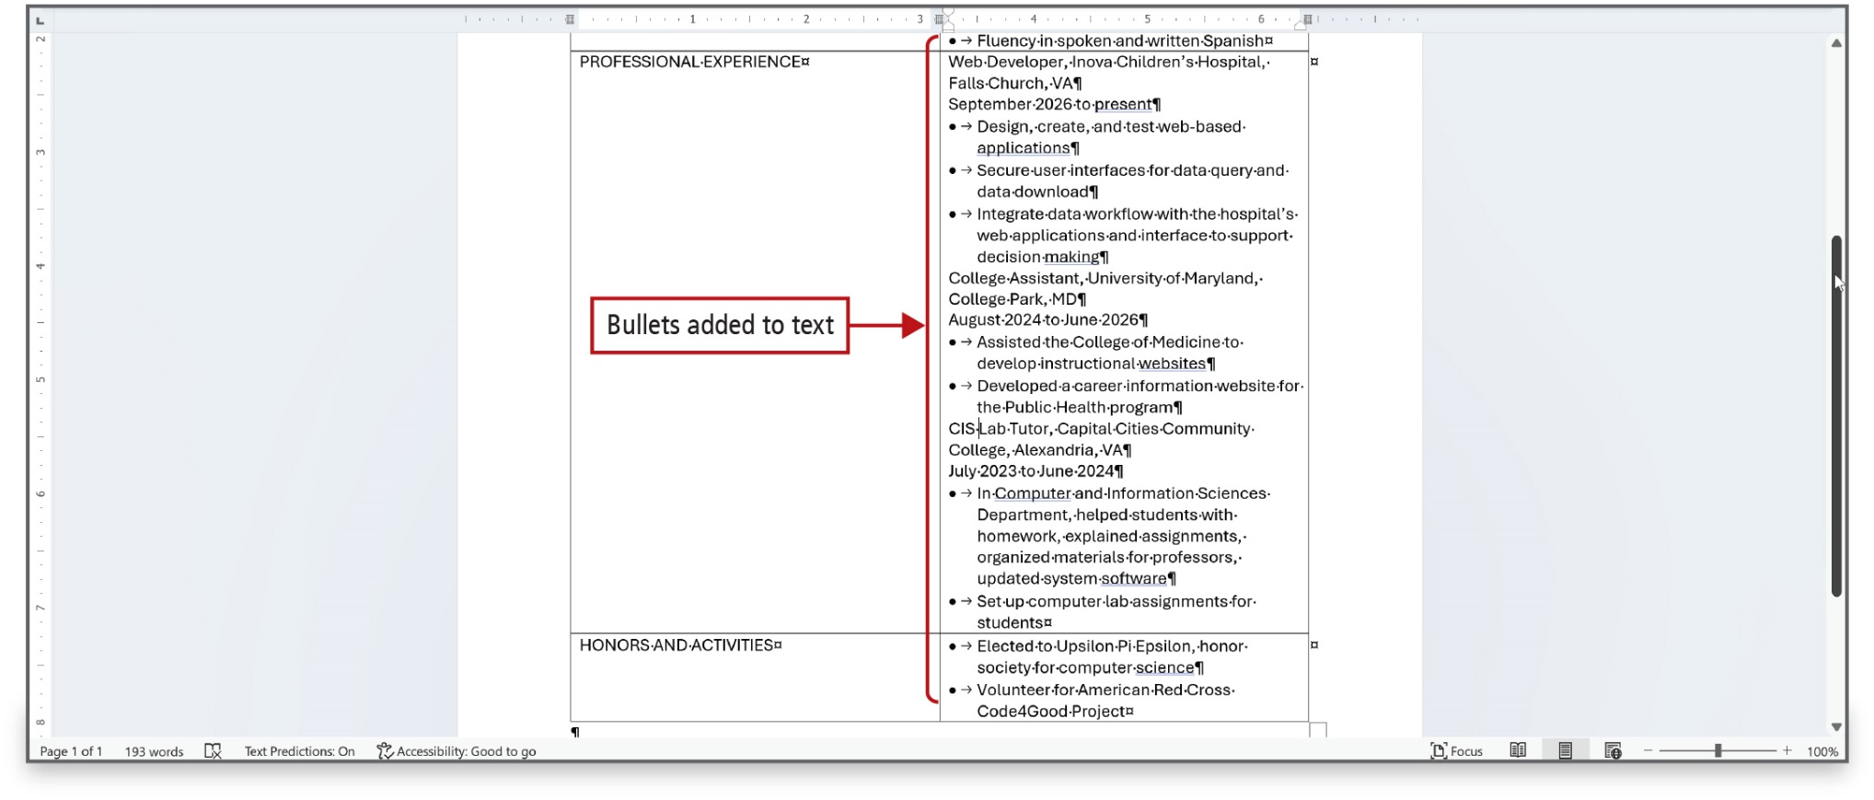
Figure 2.8
Notes:
Bullets can be added to text in one or more cells in a table.

Slide 10
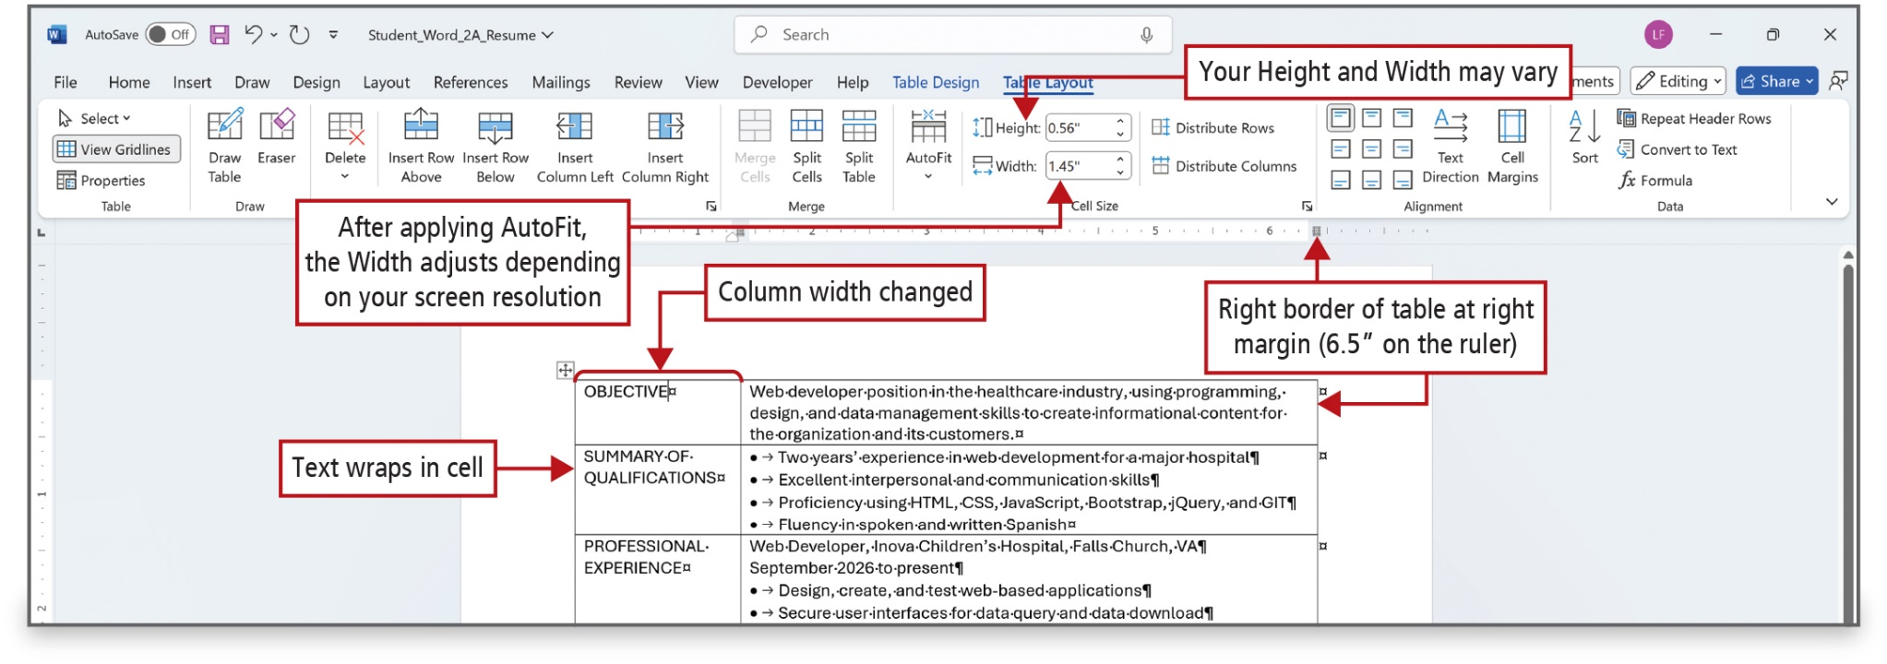
Figure 2.9
Notes:
When you create a table, all of the columns are of equal width. Adjusting column width by dragging a column border adjusts only the width of the column. Adjusting column width with the Width box simultaneously adjusts the right border of the table. Column widths can also be adjusted by dragging the Move Table Column markers on the ruler.

Slide 11
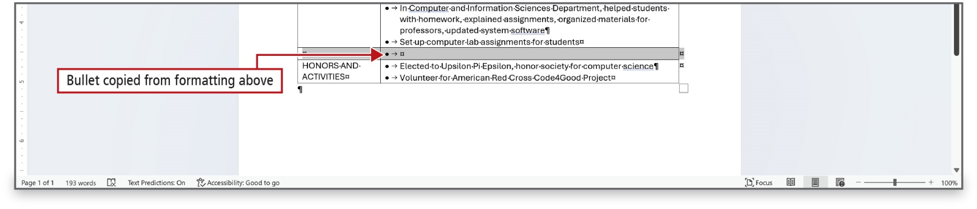
Figure 2.10
Notes:
The One-click Row/Column Insertion button on the left edge or top of a table can be used to easily and quickly insert a row or column in a table.

Slide 12
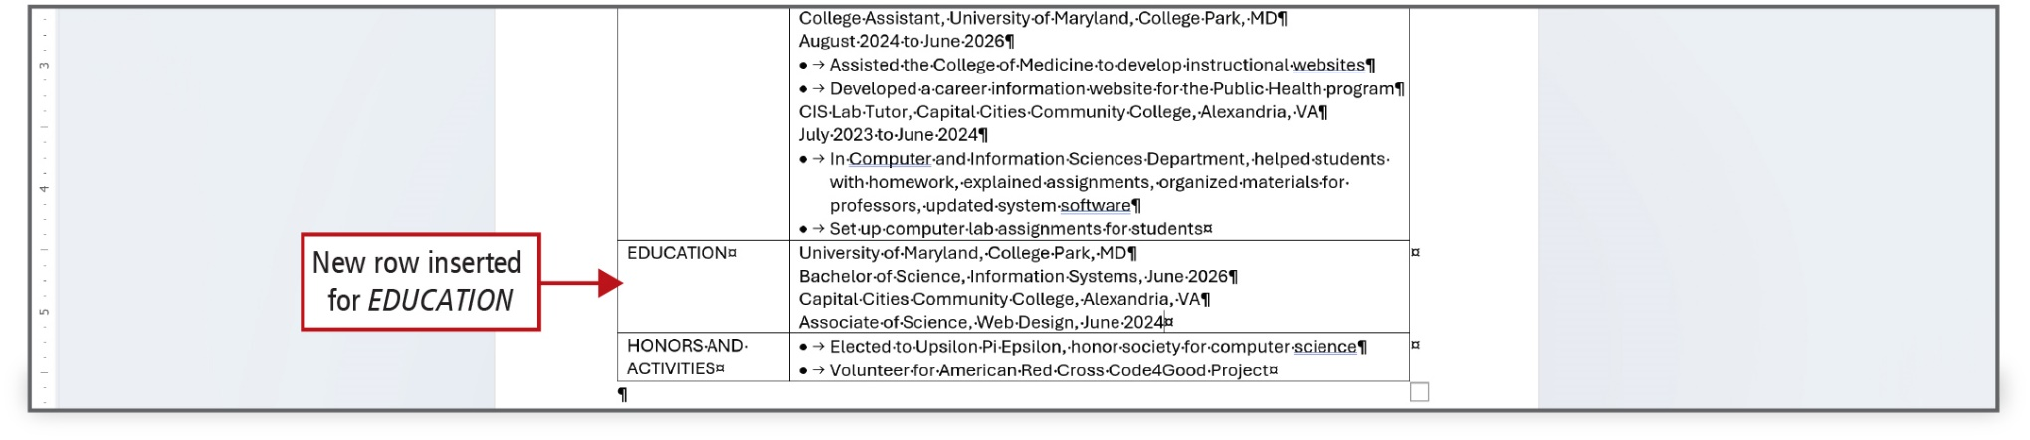
Figure 2.11
Notes:
When the insertion point is in the last cell in the bottom row of a table, you can add a row by pressing the Tab key.

Slide 13
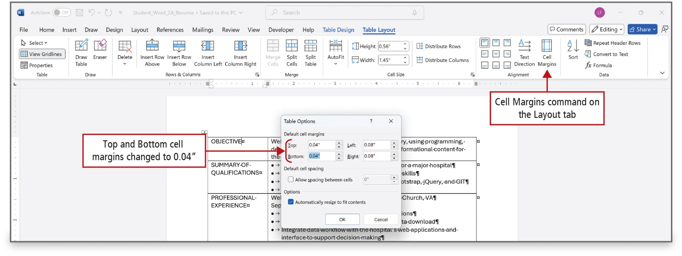
Figure 2.12
Notes:
Cell margins refer to the space inside a table cell between the text and the cell borders—top, bottom, left, and right.

Slide 14
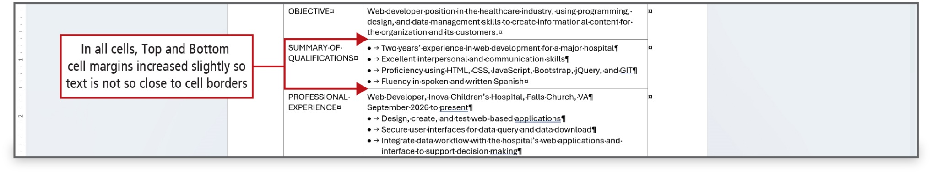
Figure 2.13
Notes:
This figure shows that the space between the text and the top and bottom of each cell has been increased, making it easier to read the text in the table.
You can merge cells by selecting the cells that you want to merge and then right-click and select Merge Cells.

Slide 15
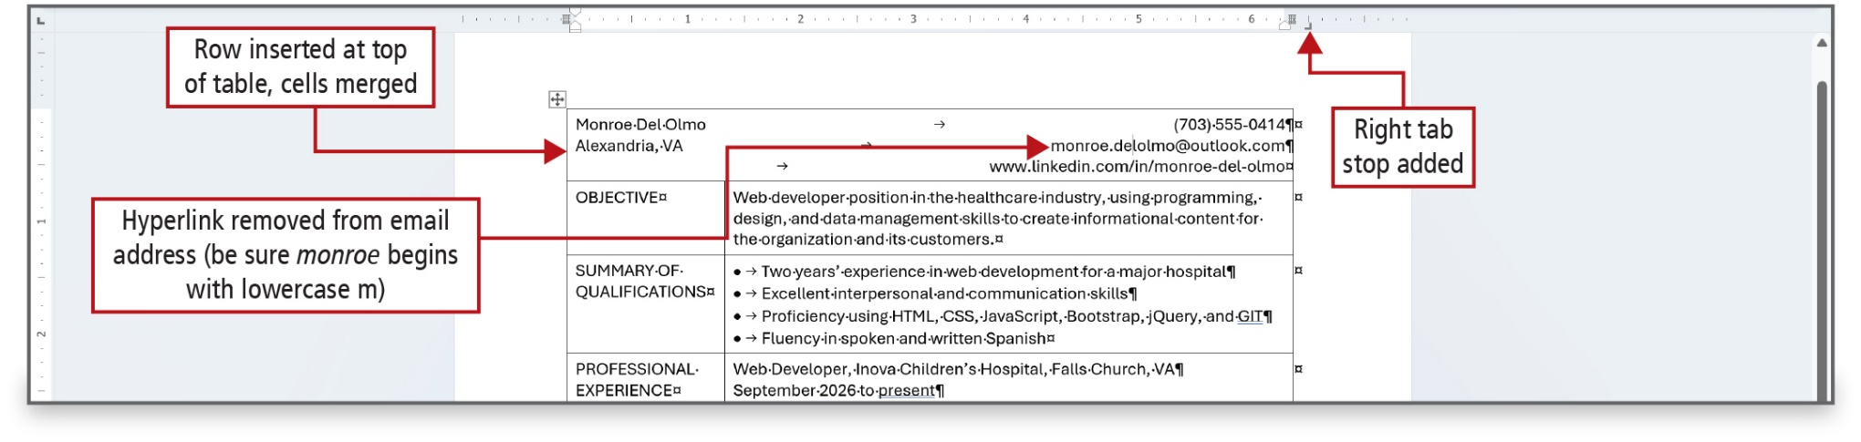
Figure 2.14
Notes:
LinkedIn is a professional networking website that focuses on business and employment-oriented services and on which you can build and share your professional identity and connect with others in your field of interest.
In a table, you can add borders to the entire table, to a paragraph within the table, or to an individual cell in the table.
This figure shows that several changes have been made to the table—row inserted, cells merged, a hyperlink has been removed.
Long Description:
It shows the Ruler selection and View tab on the toolbar. Annotations point to specific paragraphs within the document: one indicating a paragraph with a left indent and a right indent, another showing a paragraph with a first-line indent, and a third highlighting a paragraph with a hanging indent.

Slide 16
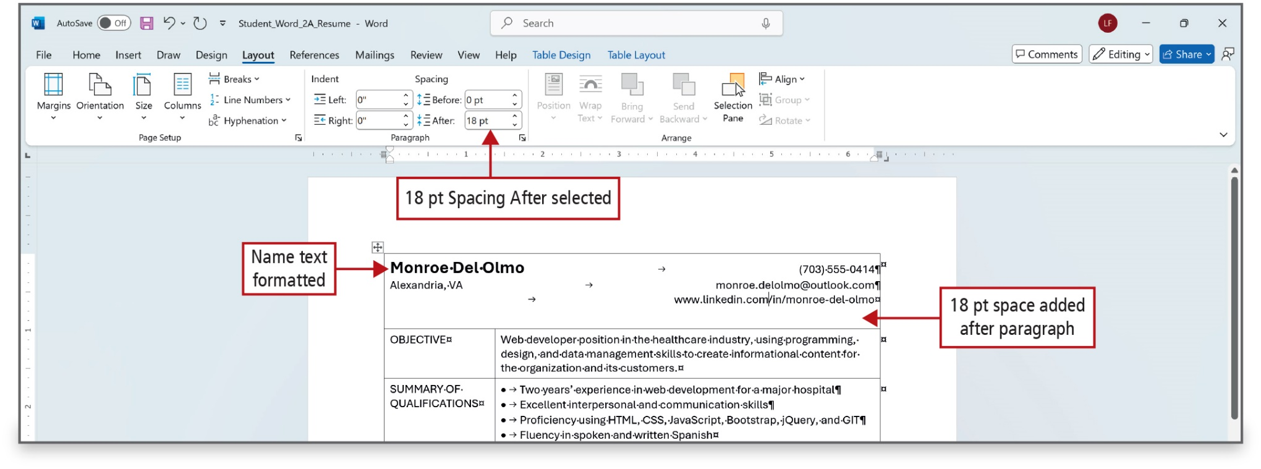
Figure 2.15
Notes:
This figure shows that two changes have been made to the table—text formatting and spaces added after a paragraph.

Slide 17
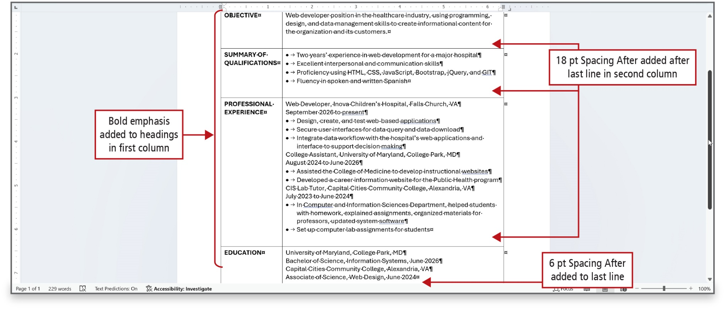
Figure 2.16
Notes:
This figure shows that several changes have been made to the table—text formatting and spaces added after a line.
Long Description:
The screenshot of a Word document highlights various tab settings and document formatting options. On the left side, there is a Tab selector with the Left tab selected indicated. Below that, the Left tab is shown on a ruler. On the right side, there is a box with options such as Type a tab stop position, Selecting an existing tab to modify, Select a tab alignment, and Select a leader. In the center, a sample shows a business schedule with days of the week and operating hours, formatted with dots as a leader, demonstrating the use of tabs in document layout.

Slide 18
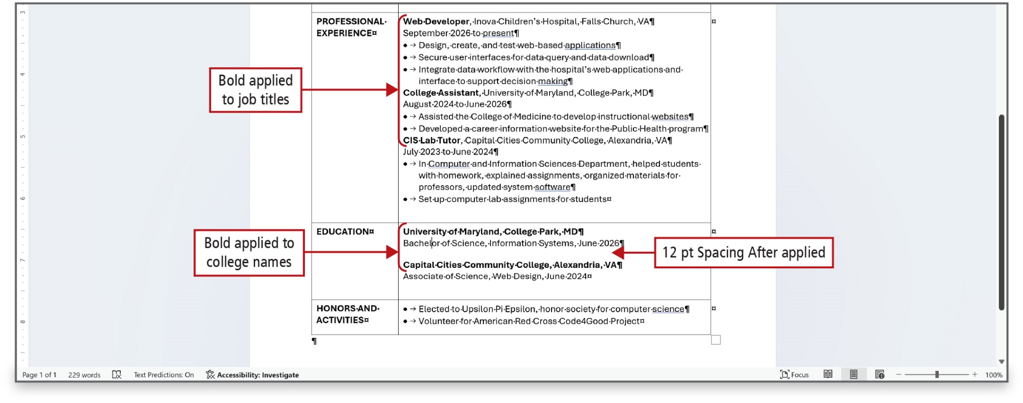
Figure 2.17
Notes:
This figure shows that bold has been applied to selected text, and spacing after has been applied to a single line.

Slide 19
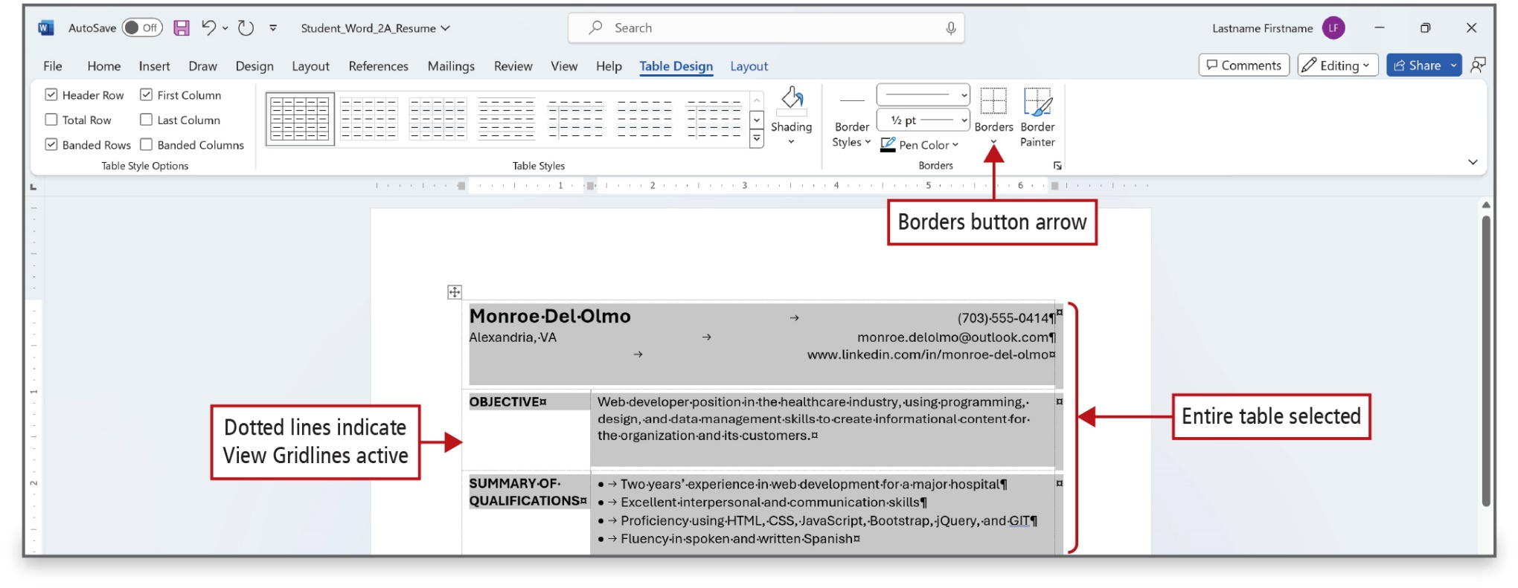
Figure 2.19
Notes:
When a table is created, all the cells have black 1/2-point, single-line, solid-line borders that print unless they are removed. Most resumes do not display any cell borders. A stylized border at the top and bottom of the resume, however, is attractive and adds a professional look to the document.
If the display of borders is turned off, you can show table gridlines to help you see where each cell is located.
Long Description:
It shows a section of the ribbon menu with options for bullets, bullets with an arrow, numbering, and numbering with an arrow. Below the ribbon, there are three examples of list formats: a bulleted list, a numbered list, and a multilevel list.

Slide 20
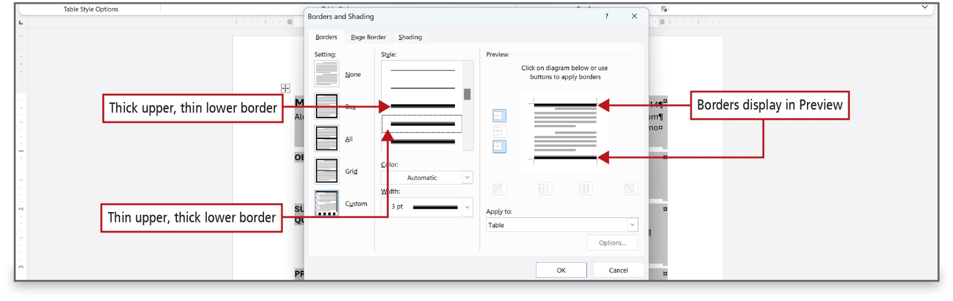
Figure 2.20
Notes:
This figure shows two borders selected and they display in Preview.
Long Description:
The Border and Shading dialog box has three tabs: Borders (selected), Page Border, and Shading. The Borders tab displays the Style, Color, and Width sections. The Setting pane is on the left and the Preview pane is on the right. The Style dropdown has a set of border settings with a thin layer over a thick line chosen. The corresponding callout reads, Thin upper, thick lower border. The previous line is a thick layer over a thin line. A callout pointing to it reads, Thick upper, thin lower border. A preview in the Preview pane has top and bottom thick borders. The corresponding callout reads, Borders display in Preview.

Slide 21
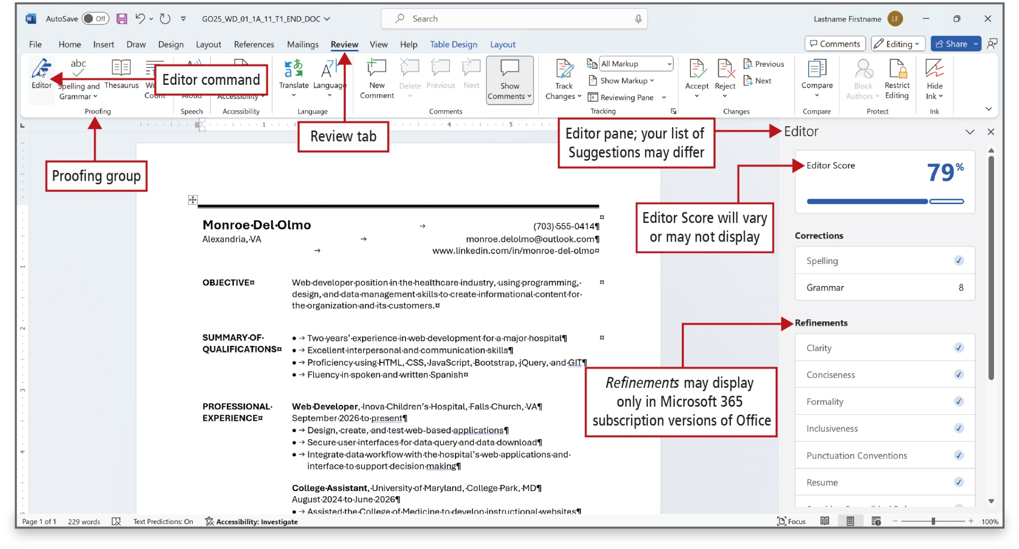
Figure 2.21
Notes:
The Editor pane can be used to make changes to a table.
To display the Editor pane, go to the Review tab, and then in the Proofing group, select Editor to display the Editor pane on the right.
Long Description:
The Editor command in the Proofing group under the Review tab is selected. The command, group, and the tab are annotated. A label for the Editor pane reads, Editor pane; your list of suggestions may differ. The Editor pane shows three sections: Editor Score, Corrections, and Refinements. The section Editor Score displays 79 percent. The section Corrections shows Spelling and Grammar. The section Refinements shows aspects such as Clarity, Conciseness, Formality, Inclusiveness, Punctuation Conventions, and Resume. A label pointing to Editor Score reads, Editor score will vary or may not be displayed. A label pointing to Refinements reads, Refinements may display only in Microsoft 365 subscription versions of Office.

Slide 22
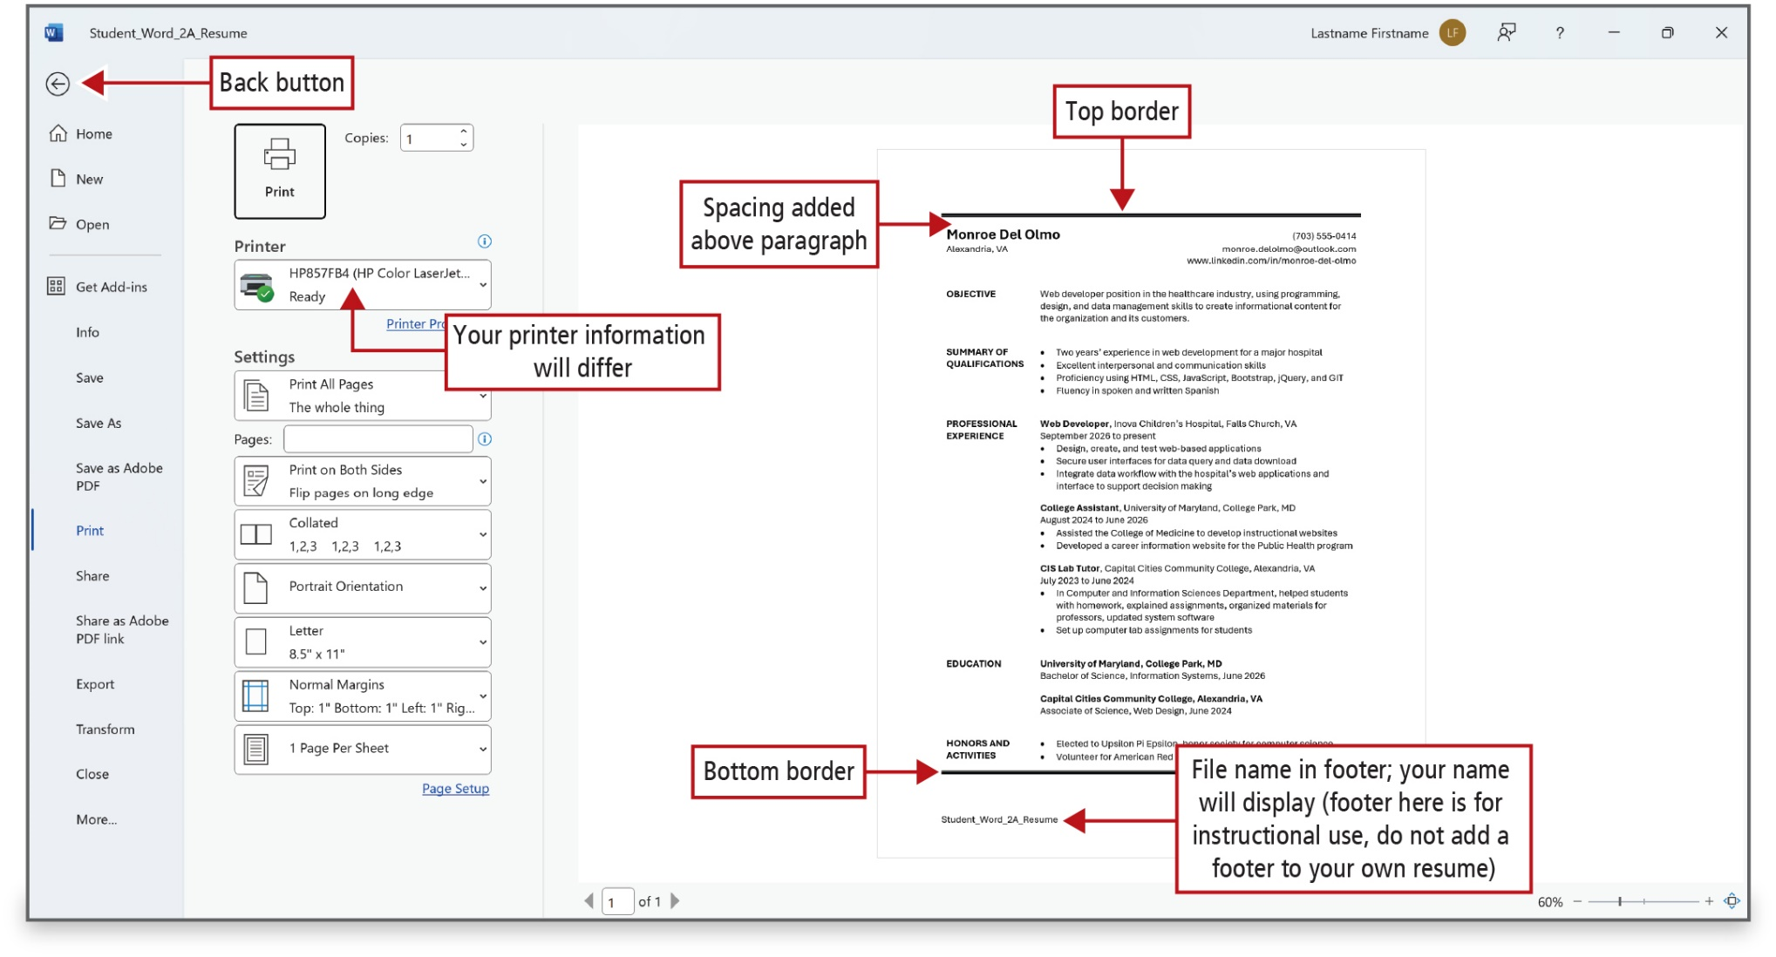
Figure 2.22
Notes:
Press C t r l + P to display Print Preview.
Long Description:
The Back button is labeled on the top left. The left pane shows tabs such as Home, New, Open, Info, Save, Print, and so on. To the right are the Print icon and copies, the Printer field, and the Settings section. The preview pane is on the right. A label for the option in Printer reads, Your printer information may differ. The top line in the preview is labeled Top border, and the bottom line is labeled Bottom border. A label pointing to spacing above the name on top in the preview pane reads, Spacing added above paragraph. A label pointing to the footer file name reads, File name in footer; your name will display (footer here is for instructional use, do not add a footer to your own resume).

Slide 23
Create a Letterhead for a Cover Letter
Letterhead—personal or company information displayed at the top of a letter
Manual line break—moves the text to the right of the insertion point to a new line
Line break indicator—indicates a manual line break
Style set—collection of character and paragraph formatting that is stored and named
Notes:
A letterhead is the personal or company information that displays at the top of a letter, and which commonly includes a name, address, and contact information. The term also refers to a piece of paper imprinted with such information at the top.
A manual line break moves the text to the right of the insertion point to a new line while keeping the text in the same paragraph. A line break indicator, in the shape of a bent arrow, indicates a manual line break.
A style set is a collection of character and paragraph formatting that is stored and named.

Slide 24
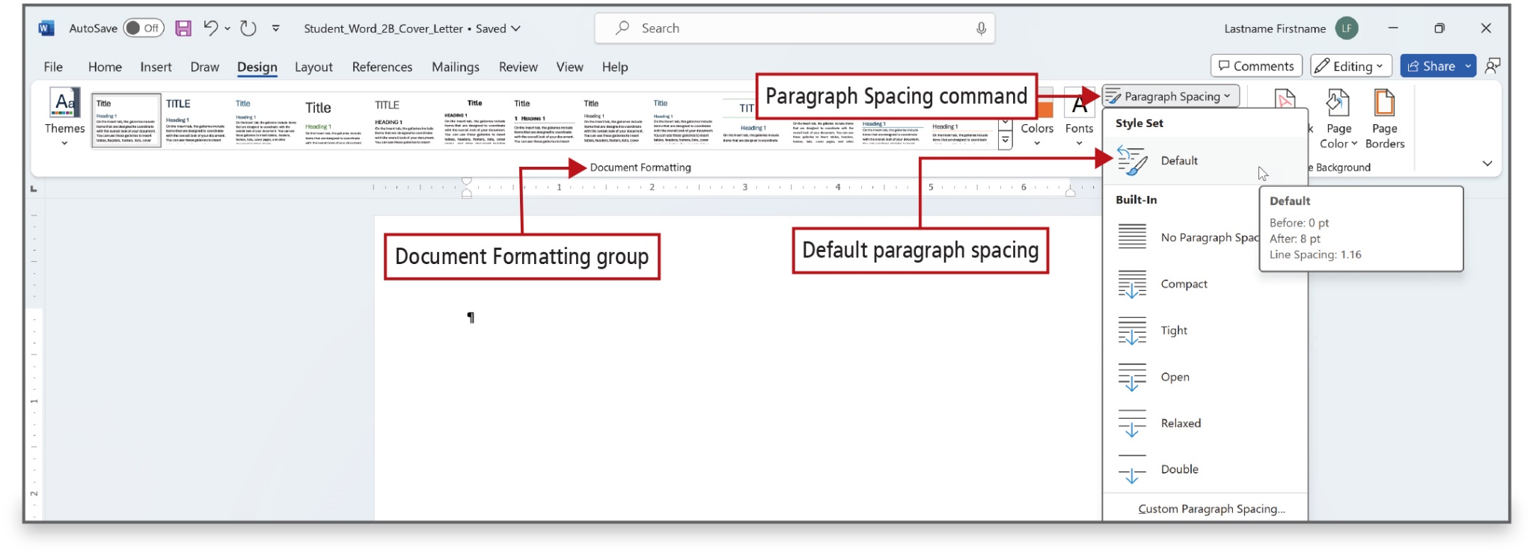
Figure 2.24
Notes:
The default paragraph spacing for a new Word document when you open Word and click Blank document, is 0 points of blank space before a paragraph, 8 points of blank space following a paragraph.
Long Description:
The menu in the Paragraph Spacing command shows sections such as Style Set and Built-In. A label pointing to the option Default in Style Set reads, Default paragraph spacing. A ScreenTip over Default shows Before, After, and Line Spacing settings.

Slide 25
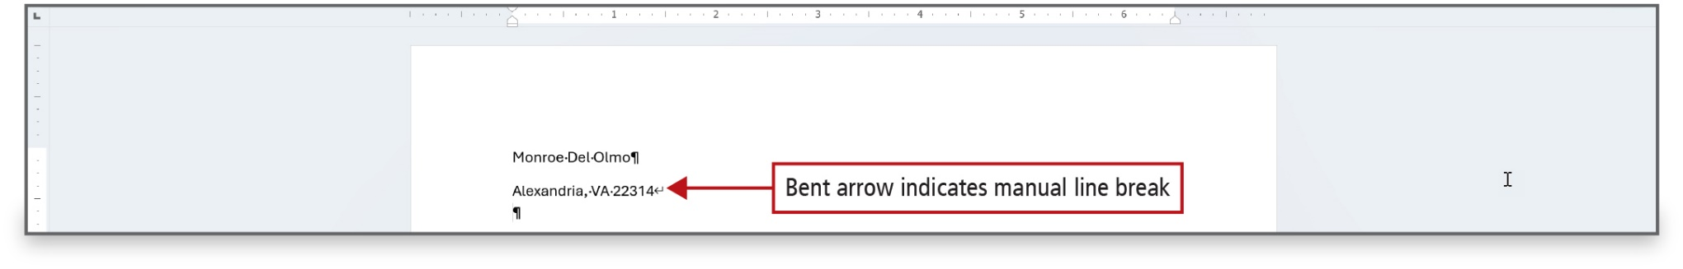
Figure 2.26
Notes:
Hold down Shift while pressing Enter to insert a manual line break, which moves the text to the right of the insertion point to a new line while keeping the text in the same paragraph.
As seen in this figure, the line break indicator is in the shape of a bent arrow and indicates a manual line break.

Slide 26
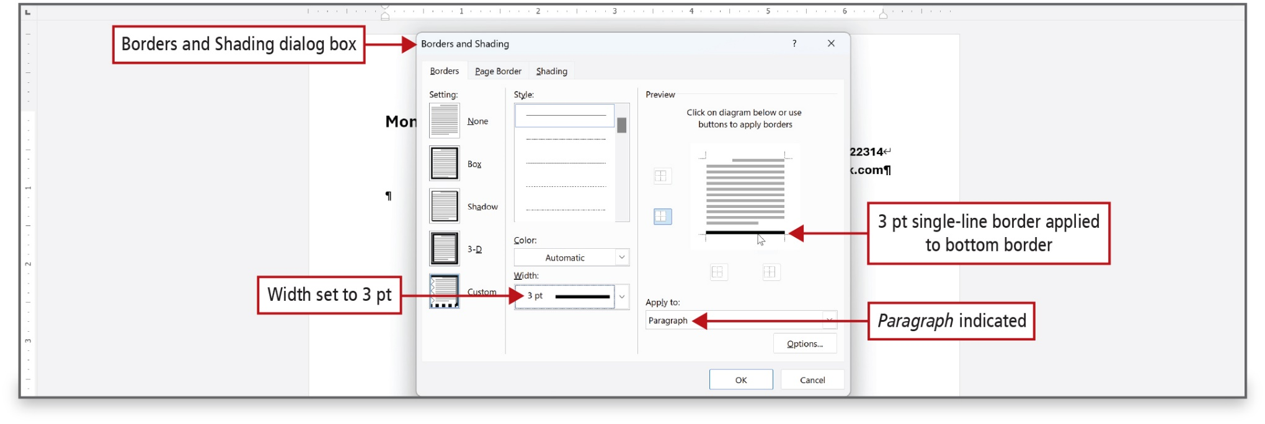
Figure 2.27
Notes:
As shown in the figure, the Borders and Shading dialog box allows the selection several options.
Long Description:
The dialog box shows the Setting, Style, and Preview sections. The annotations are as follows: the dialog box: Borders and Shading dialog box; the Width dropdown: Width set to 3 p t; the bottom border in the Preview section: 3 p t single-line border applied to bottom border; the Apply to dropdown in the Preview section: Paragraph indicated.

Slide 27
Create a Cover Letter and Correct and Reorganize Text (1 of 2)
Cover letter—document sent with resume to provide Information:
Skills
Experience
Qualifications
Interest
Notes:
A cover letter is a document that you send with your resume to provide additional information about your skills and experience. An effective cover letter includes specific information about why you are qualified for the job for which you are applying. The cover letter is also used to explain your interest in the position and the organization.

Slide 28
Create a Cover Letter and Correct and Reorganize Text (2 of 2)
Business letter format/parts:
Current date
Name and address of recipient
Greeting
Text of the letter
Closing line
Writer’s identification or writer’s signature block
Also may be included:
Initials of preparer
Optional subject line
List of enclosures
Notes:
Business letters follow a standard format and contain the following parts:
Current date, referred to as the dateline.
Name and address of the person receiving the letter, referred to as the inside address.
Greeting, referred to as the salutation.
Text of the letter, usually referred to as the body of the letter.
Closing line, referred to as the complimentary closing.
Writer’s identification or writer’s signature block, which includes the name of the writer and sometimes the writer’s job title.
Some letters also include:
Initials of the person who prepared the letter
Optional subject line that describes the purpose of the letter
List of enclosures—documents included with the letter.

Slide 29
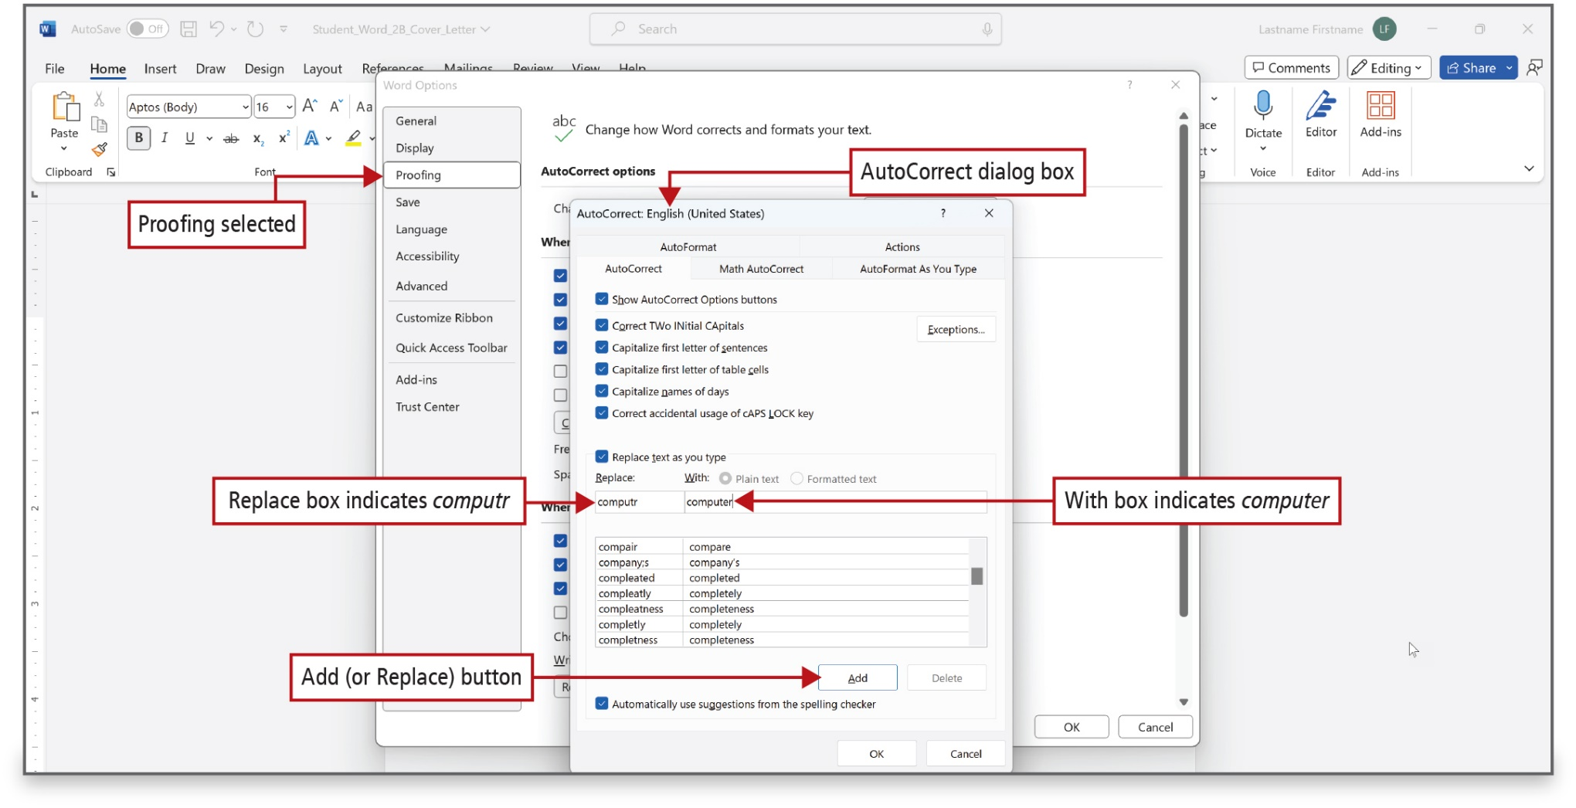
Figure 2.28
Notes:
Word’s AutoCorrect feature corrects commonly misspelled words automatically; for example, teh is correct to the. This can be very helpful with business letter writing.
Long Description:
The Autocorrect dialog box shows the AutoCorrect tab selected. A list of check boxes for autocorrecting and capitalizing is followed by the Replace and With boxes. The annotations are as follows: the Proofing tab: Proofing selected; the Autocorrect dialog box; the Replace text box: Replace box indicates computer; the Width text box: With box computer; the Add button: Add (or Replace) button.

Slide 30
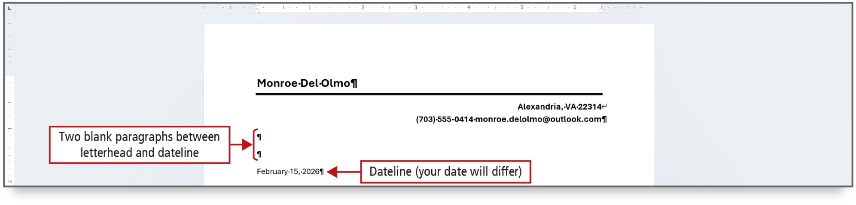
Figure 2.29
Notes:
The Date & Time command is used to select a variety of formats to insert the current date and time in a document. After the date is inserted in a business letter, one to 10 blank lines, depending on the length of the letter, are inserted prior to typing the inside address.

Slide 31
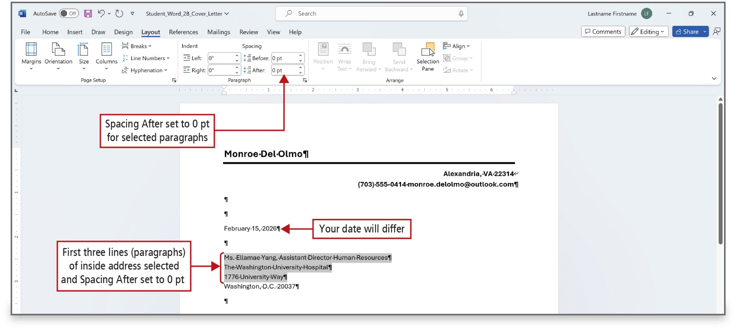
Figure 2.30
Notes:
Two parts of a business letter—the inside address and the writer’s signature block if it is more than one line—are commonly described in terms of single-spaced paragraphs where there is no blank space following a paragraph. By changing the spacing after paragraphs for all but the last line of the inside address, you will be following the prescribed format of a letter.
Long Description:
The Paragraph group under the Layout tab has spin boxes under Indent as Left and Right and Spacing as Before and After. A label pointing to After reads, Spacing After set to 0 p t for selected paragraphs. A label pointing to a date reads, Date is labeled your date will differ. A label pointing to the selected paragraphs reads, First three lines (paragraphs) of inside address selected and Spacing After is set to 0 p t.

Slide 32
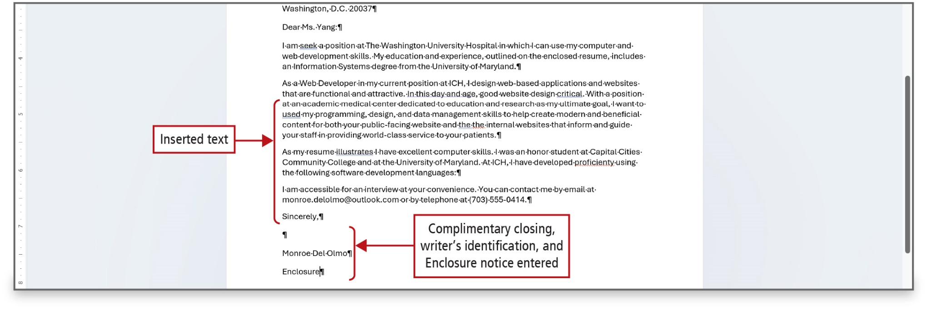
Figure 2.32
Notes:
After entering the inside address and body, the cover letter is concluded by the complementary closing

Slide 33
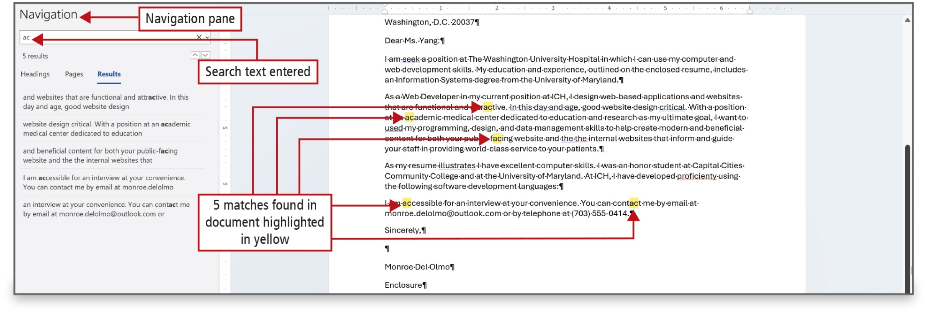
Figure 2.33
Notes:
Once the cover letter is completed, you might need to replace some wording. The Find command is used to locate text in a document quickly, and the Find and Replace command is used to make the same change, or to make more than one change at a time, in a document.

Slide 34
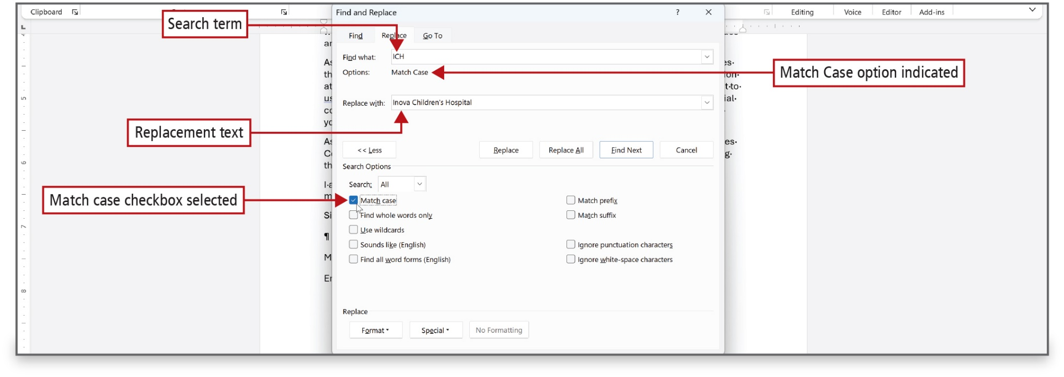
Figure 2.34
Notes:
As shown in the figure, the Find and Replace dialog box allows the selection several options.
Long Description:
It has three tabs: Find, Replace, and Go To. The Replace tab shows the Find what and Replace with text boxes followed by check boxes under the section Search Options. The option Match case is selected this section. The labels are as follows: Find what: Search term; Options: Match Case under Find what: Match Case option indicated; Replace with: Replacement text; the check box Match case in Search Options: Match case checkbox selected.

Slide 35
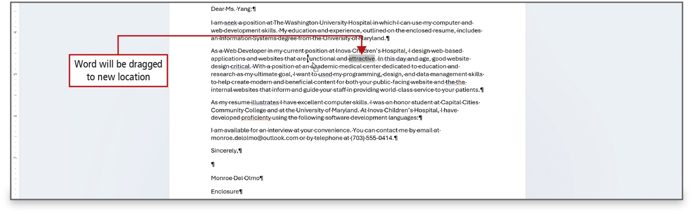
Figure 2.36
Notes:
The drag-and-drop feature uses the mouse to drag selected text from one location to another. See Figure 2.35 in the text for a list of text selection methods.
This figure shows the selected word is shaded gray.

Slide 36
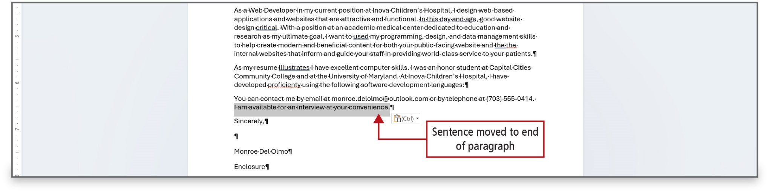
Figure 2.38
Notes:
By using Word’s drag-and-drop feature, you can use the mouse to drag selected text from one location to another.

Slide 37
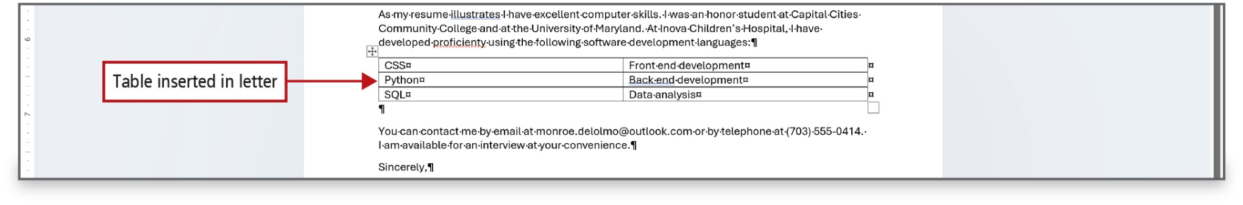
Figure 2.39
Notes:
The help organize text, a table can be inserted into a document. As shown in the slide, a 2 by 3 table has been inserted and formatted.

Slide 38
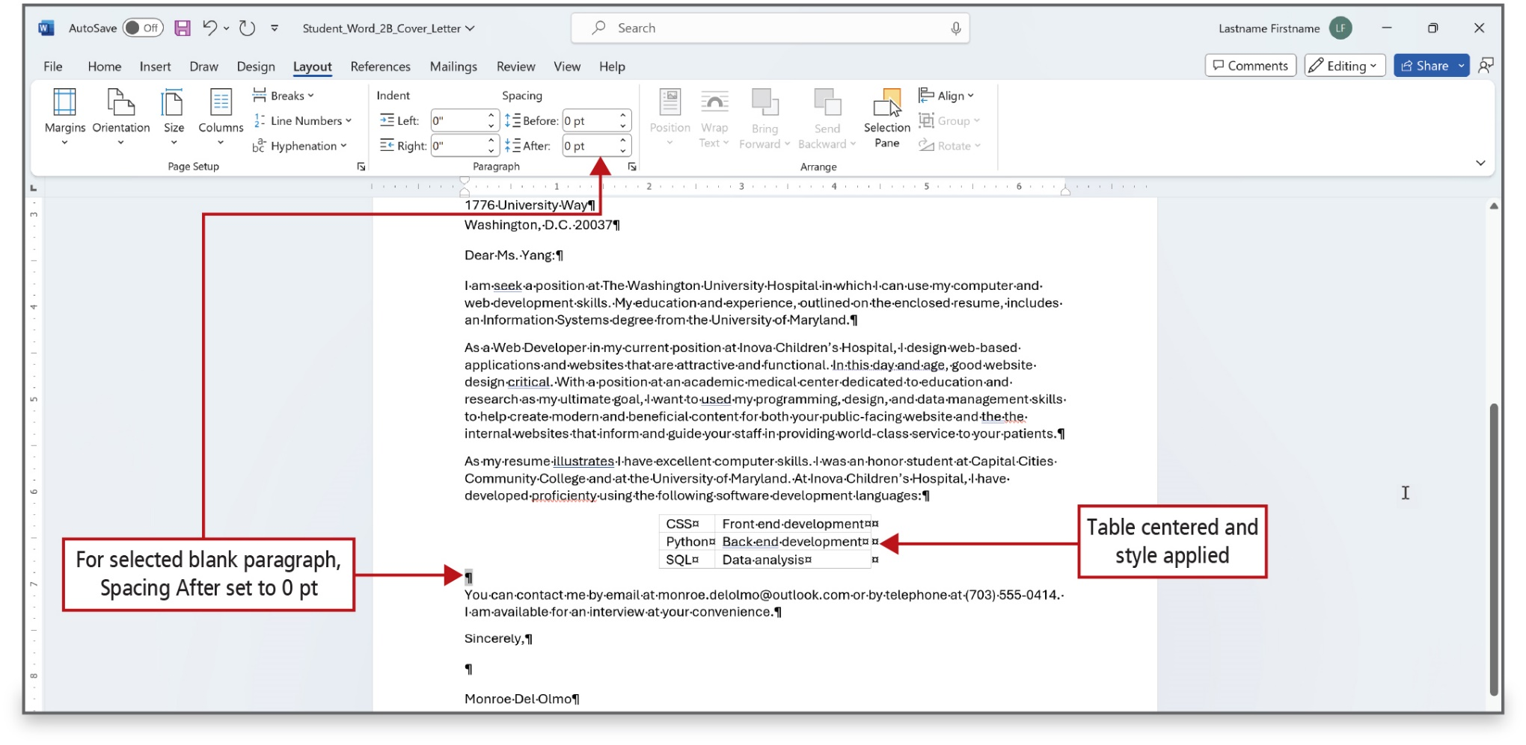
Figure 2.40
Notes:
This figure shows that the table from the previous slide has been centered, and a style applied to it.
Long Description:
The Paragraph group under the Layout tab has spin boxes under Indent as Left and Right and Spacing as Before and After. A label pointing to After reads, For selected blank paragraph, Spacing After set to 0 p t. A label pointing to a table reads, Table centered and style applied.

Slide 39
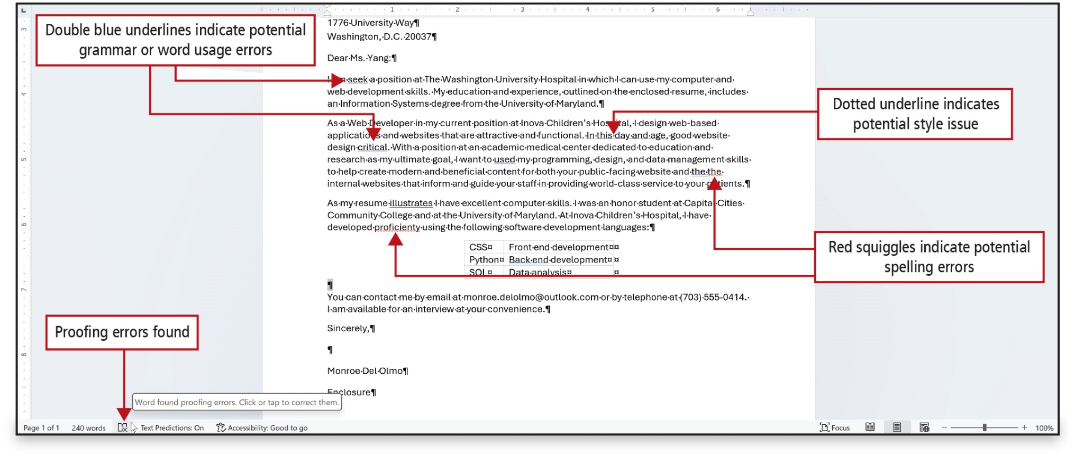
Figure 2.41
Notes:
Word Editor will analyze a document and offer suggestions for spelling, grammar, and stylistic issues such as making sentences more concise, choosing simpler words, or writing in a more formal style.
There are two ways to respond to spelling, grammar, and style items flagged by Word:
Right-click a flagged word or phrase and from the shortcut menu choose a correction or action.
Launch Editor, which provides more options than the shortcut menu.
Long Description:
The annotations are as follows: double underlined words for grammar or word usage errors: Double blue underlines indicate potential grammar or word usage errors; a dotted underline for a compound phrase: Dotted underline indicates potential style issue; a wriggled word: Red squiggles indicate potential spelling errors; a book symbol with a cross mark on the status bar: Proofing errors; a ScreenTip for proofing: Proofing errors found.

Slide 40
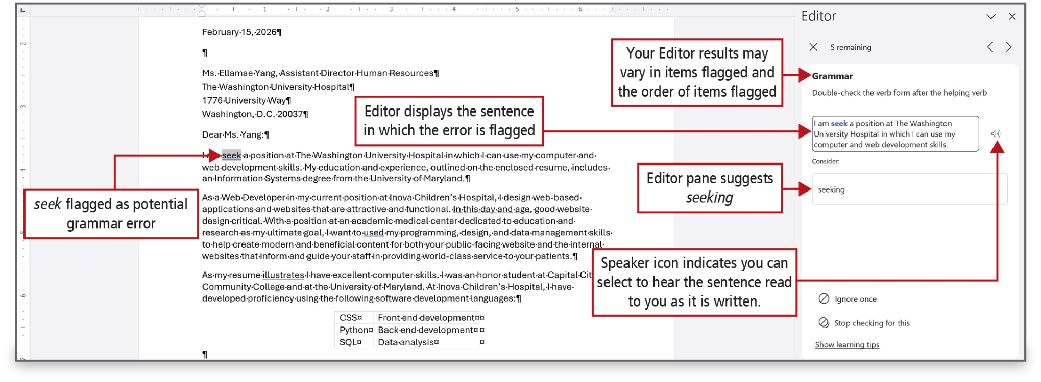
Figure 2.42
Notes:
Word’s dictionary contains only very common proper names—less common names like this may be flagged as a
potential spelling error. If there is a name that you frequently enter, consider adding it to the dictionary.
The Grammar pane explains the potential grammar error.
Long Description:
The Editor pane is shown on the right, and a label for the section Grammar in the Editor pane reads, Your editor results may vary in items flagged and the order of items flagged. A label pointing to a text box below reads, Editor displays the sentence in which the error is flagged. The Consider text box follows the above text box. A label pointing to the Consider box reads, Editor pane suggests seeking. A speaker icon next to the first text box reads, Speaker icon indicates you can select to hear the sentence read to you as it is written. A label pointing to the word seek in the document reads, Seek flagged as potential grammar error.

Slide 41
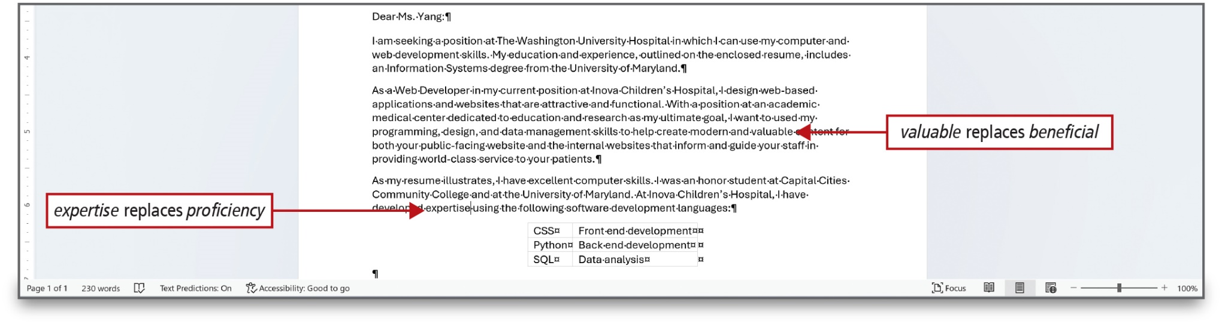
Figure 2.43
Notes:
A thesaurus is a research tool that lists synonyms—words that have the same or similar meaning to the word you selected. When you right-click a word in a document and click Thesaurus, the Thesaurus pane opens on the right. A word can then be selected to replace the existing word.

Slide 42
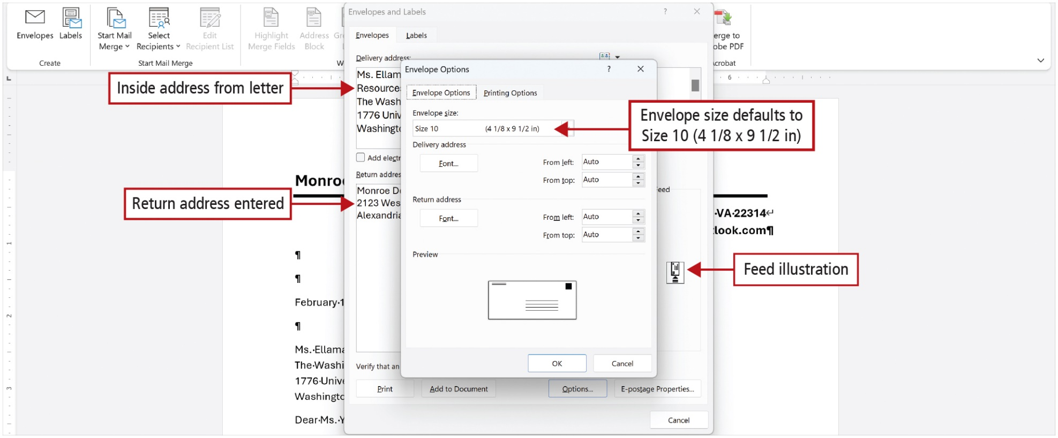
Figure 2.44
Notes:
Word’s Create Envelopes command enables you to choose the envelope size, format the addresses, and add electronic postage to an envelope.
Long Description:
Envelopes and Labels dialog box shows two tabs: Envelopes (selected) and Labels. The Envelopes tab shows two text boxes: Delivery address and Return address. The address in Delivery address is labeled inside address from letter. The address in Return address is labeled Return address entered. The Envelope Options dialog box shows two tabs: Envelope Options (selected) and Printing Options. The Envelope Options dialog box shows the Envelope size dropdown followed by the Delivery address and Return address sections with alignment positions. The Envelope size dropdown is set to Size 10 (4 and 1 over 8 by 9 and half inches). The corresponding annotation reads, Envelope size defaults to Size 10 (4 and 1 over 8 by 9 and half inches).

Slide 43
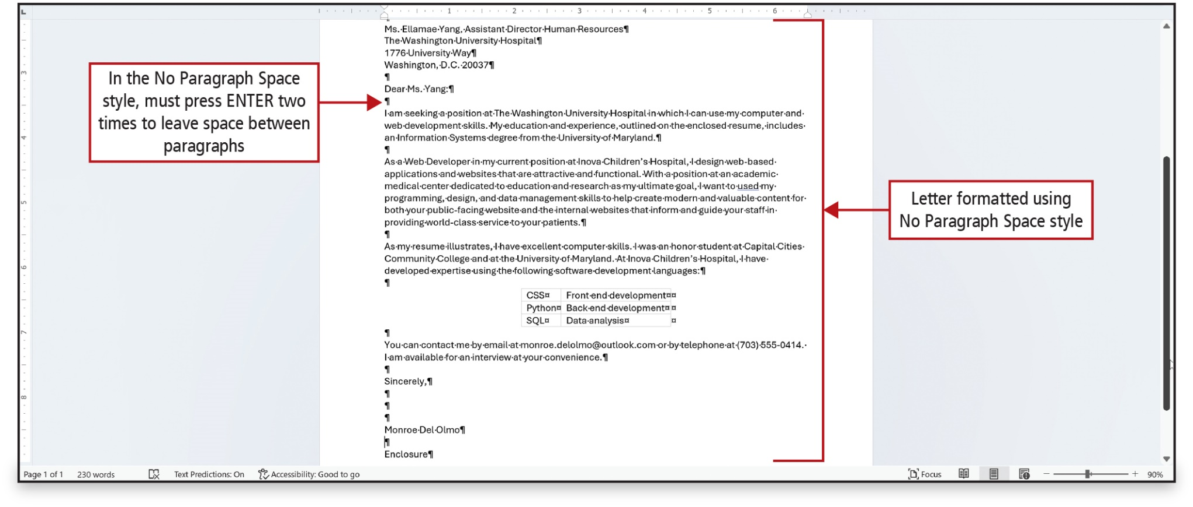
Figure 2.45
Notes:
Before printing your cover letter, you might want to make changes to its appearance by changing the style set.
Long Description:
An annotation pointing to a blank paragraph below the salutation reads, In the No Paragraph Space style, must press ENTER two times to leave space between paragraphs. An annotation pointing to the letter with no paragraph space reads, Letter formatted using No Paragraph Space Style.

Slide 44
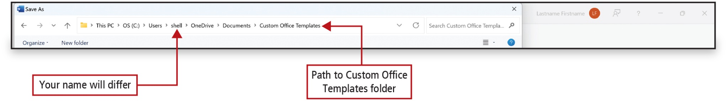
Figure 2.46
Notes:
A template is a file with a predefined document structure and defined settings, such as fonts, margins, and available styles. All documents are based on a template. When you create a new blank document, it is based on Word’s Normal template, which serves as a starting point for all blank Word documents. By default, Word stores template files on your hard drive in your user folder named Custom Office Templates.
Long Description:
The path in the address bar reads, This P C-> O S (C colon)-> Users-> shell-> OneDrive-> Documents-> Custom Office Templates. A label pointing to shell reads, Your name will differ. Another label pointing to Custom Office Templates reads, Path to Custom Office Templates folder.

Slide 45
Print an Envelope, Change a Style Set, Create a Word Template, and Use Learning Tools (1 of 2)
Learning Tools—features that add visual changes
Immersive Reader—feature in Word that adds visual changes to assist with reading fluency and comprehension
Page Color—changes the color making text easy to scan and consume
Column Width—changes the width of the line length to fit on a line
Notes:
Learning Tools are features in Word that add visual changes to assist with reading fluency and comprehension.
Immersive Reader is a feature in Word that adds visual changes to assist with reading fluency and comprehension.
The Page Color command changes the color to make the text easy to scan and consume.
The Column Width command changes the width of the line length to fit more or less text on each line.
Options include:
Very Narrow
Narrow
Moderate
Wide.

Slide 46
Print an Envelope, Change a Style Set, Create a Word Template, and Use Learning Tools (2 of 2)
Additional Learning Tools:
Text Spacing—increases spacing between words, characters, and lines.
Syllables—shows breaks between syllables of words
Read Aloud—reads text out loud
Notes:
Additional Learning Tools:
The Text Spacing command increases spacing between words, characters, and lines.
The Syllables command shows breaks between syllables of words.
The Read Aloud command reads text out loud and highlights each word as it is read.

Slide 47
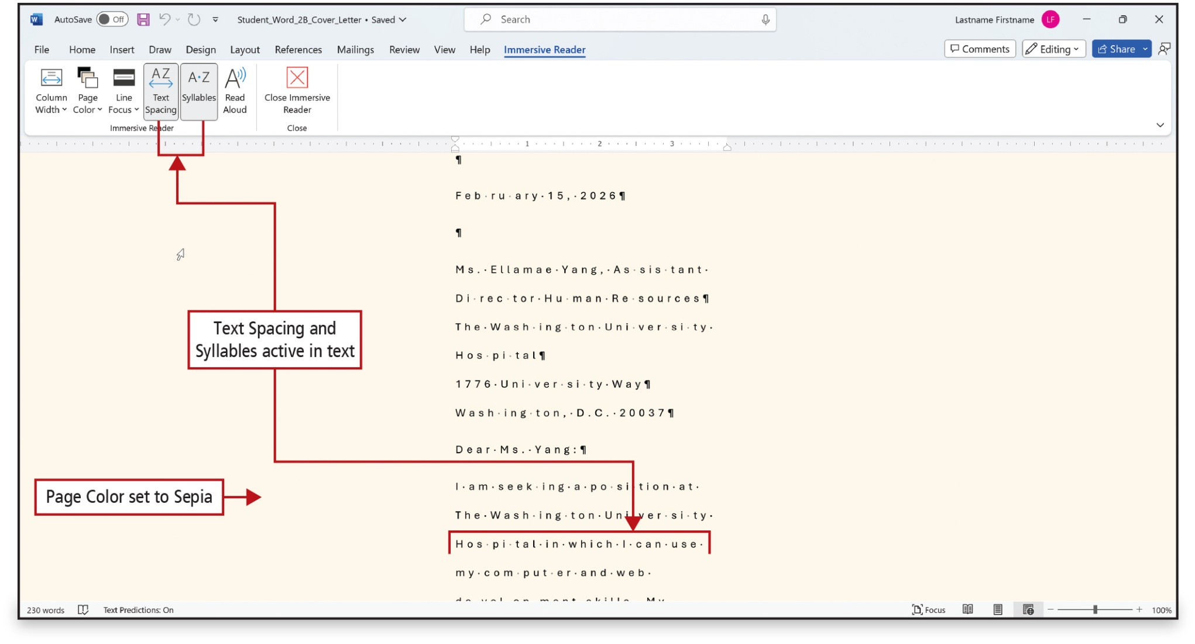
Figure 2.48
Notes:
The figure shows the application of some Learning Tools.
Long Description:
A portion of text shows text spacing and syllables. An annotation pointing to a portion of the text reads, Text Spacing and Syllables active in text. Another one pointing to the colored background reads, Page color set to Sepia.

Slide 48
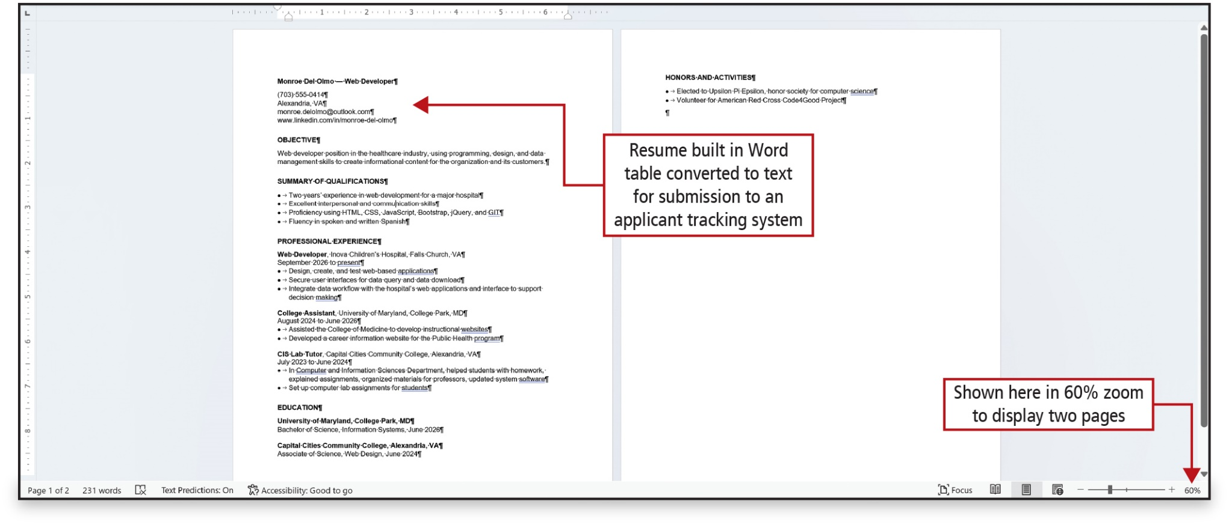
Figure 2.49
Notes:
Most employing organizations use an applicant tracking system—referred to as an A T S—to screen job candidates.
See the text for a list of do’s and don’ts for submitting a resume to an A T S. One of the don’ts is not to include any pictures, images, columns, tables, or graphics.
This figure shows the use of the Convert to Text command, which converts a table to regular text.
Long Description:
A label pointing to the sender's details reads, Resume built in Word table converted to text for submission to an applicant tracking system. Another one pointing to the zoom display reads, Shown here in 60 percent zoom to display two pages.

Slide 49

Questions

Slide 50

Copyright
This work is protected by United States copyright laws and is provided solely for the use of instructors in teaching their courses and assessing student learning. Dissemination or sale of any part of this work (including on the World Wide Web) will destroy the integrity of the work and is not permitted. The work and materials from it should never be made available to students except by instructors using the accompanying text in their classes. All recipients of this work are expected to abide by these restrictions and to honor the intended pedagogical purposes and the needs of other instructors who rely on these materials.

